Slide 1
Conversational AI Microsoft Azure Chat Bot
DAB 106 : 23w-004
Introduction to artificial intelligence
Group # 09 – Final project

Slide 2
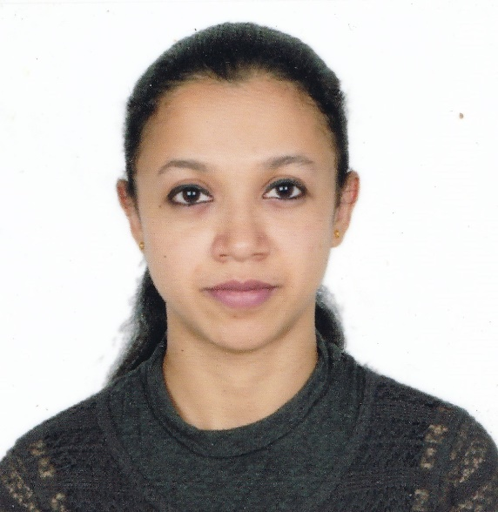
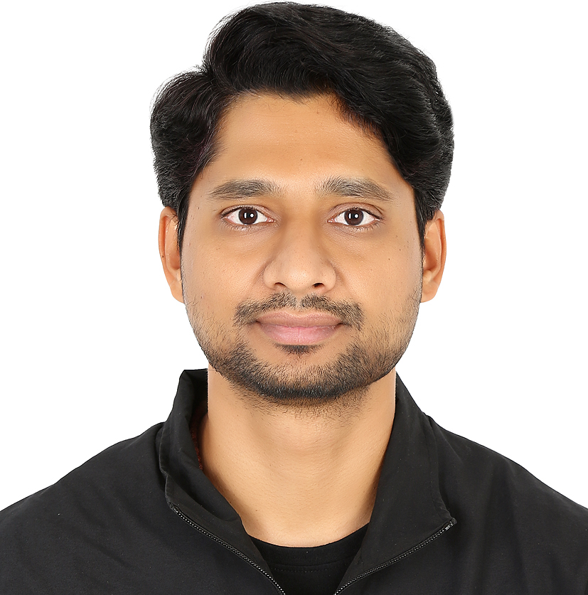

Meet Our Team
Ambily Treesa Varghese
Dileep Sathyan
Jibina Francis

Slide 3
Problem Statement:
For any new immigrant, be it an International Student or a Working Professional, it is hard to imagine a life in Canada without a Driving License. All aspiring drivers must pass a Knowledge Test to get to the G-License.
Though there are 100s of resources which describe the rules and statutory regulations about the Canadian driving license, there doesn’t exist a single resource which answers all the obvious questions a new candidate may have.
Microsoft Azure’s AI-powered QnA Chat Bot with a solid knowledge base from various resources integrated with multiple online social media platforms such as Facebook / Teams / SMS / WhatsApp will be a one-stop-solution for anyone who wishes to have a Canadian Driving License.

Slide 4
Project Proposal:
Our team shall develop an AI powered Chat bot using Microsoft Azure services by consolidating the most frequent and obvious questions along with the answers from various online resources about the regulations and conditions as to how to get a license and drive safely in Canada.
We shall further integrate the Chat bot with various social media and communication platforms such that the data is accessible for general public.

Slide 5
Hurdles Ahead & Learnings:
Lack of ready-made Knowledge Base.
Brainstorm possible questions and customize FAQs.
Implementation on Messenger by creating a new Facebook Page.
Integration to other platforms such as phone SMS (Twilio) : dropped the effort as it is a paid-version.
Integration of Chatbot to multiple Channels.
Granular understanding of Microsoft Azure Services.

Slide 6
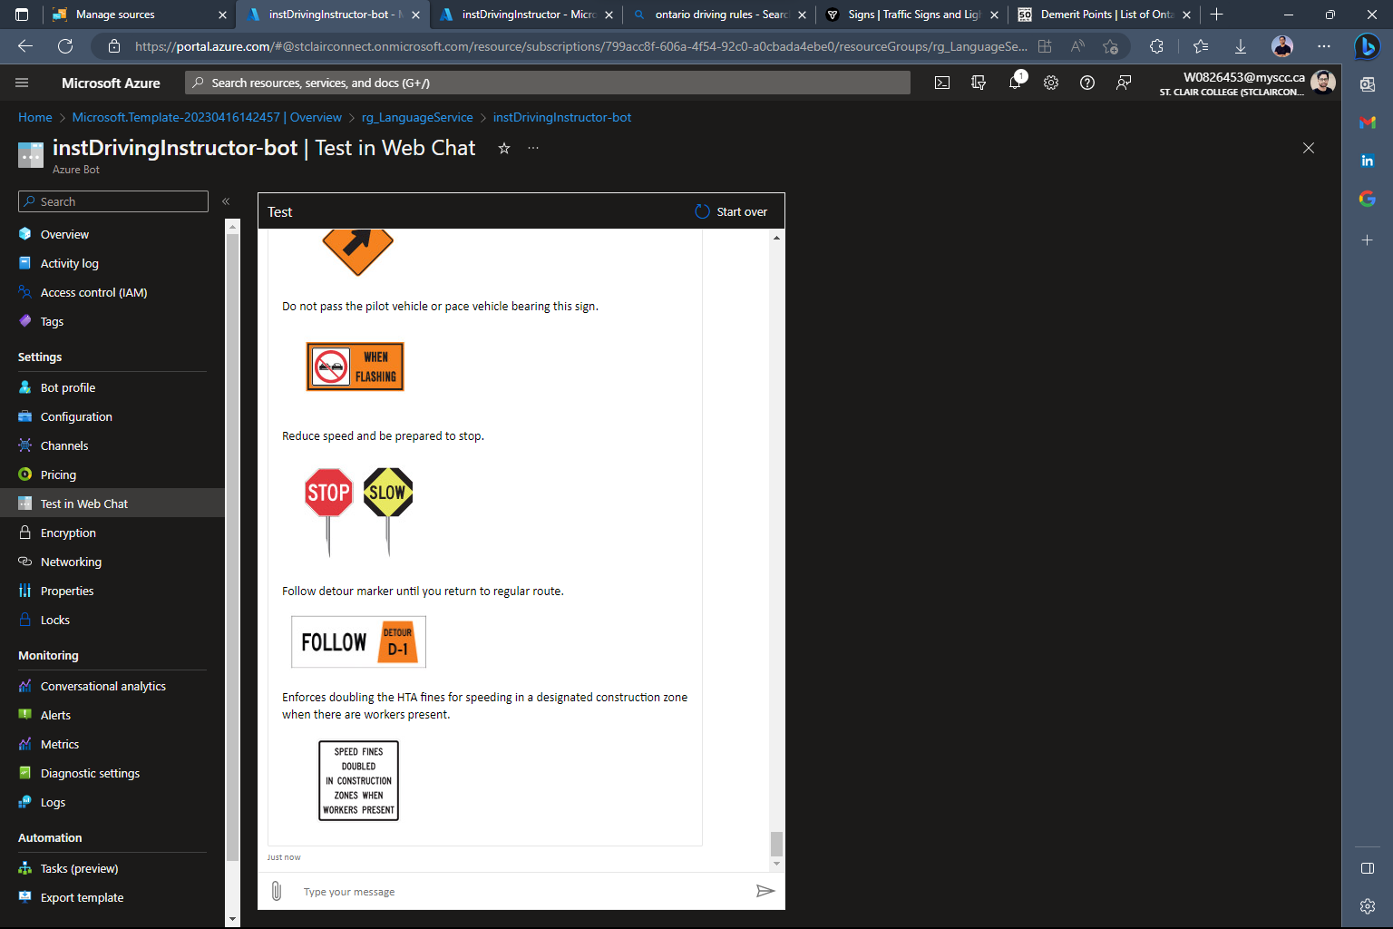
End Product: Chat Bot

Slide 7
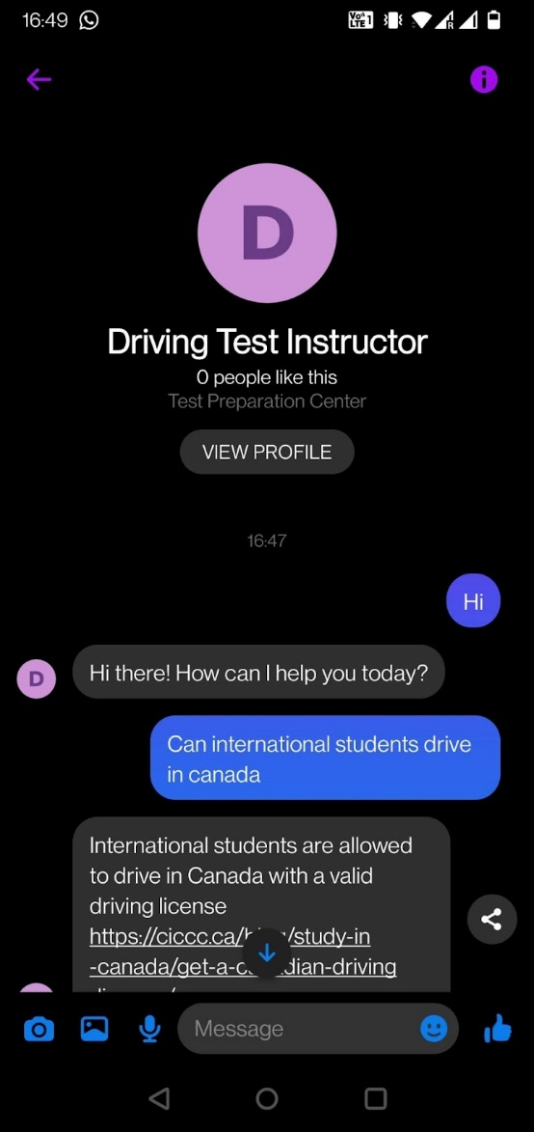
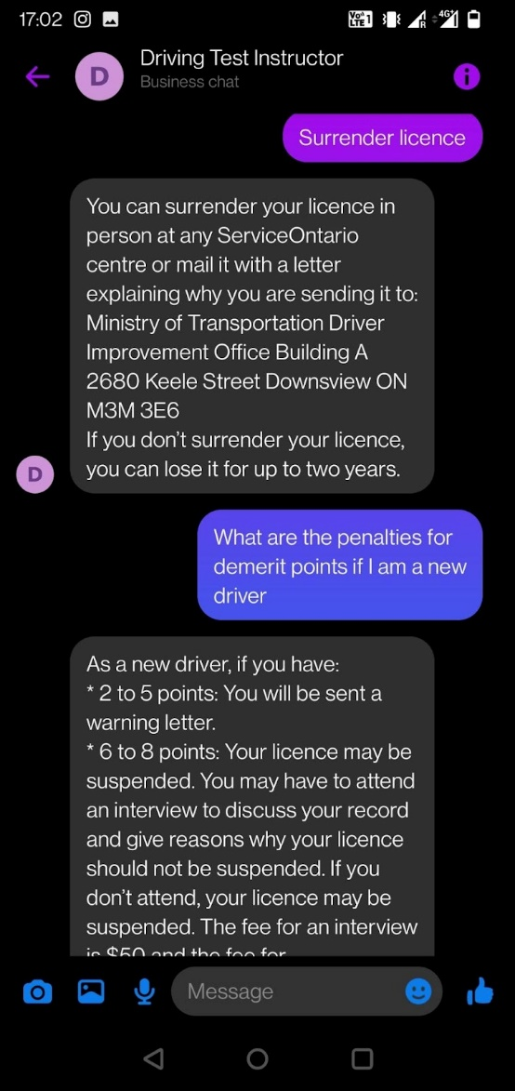
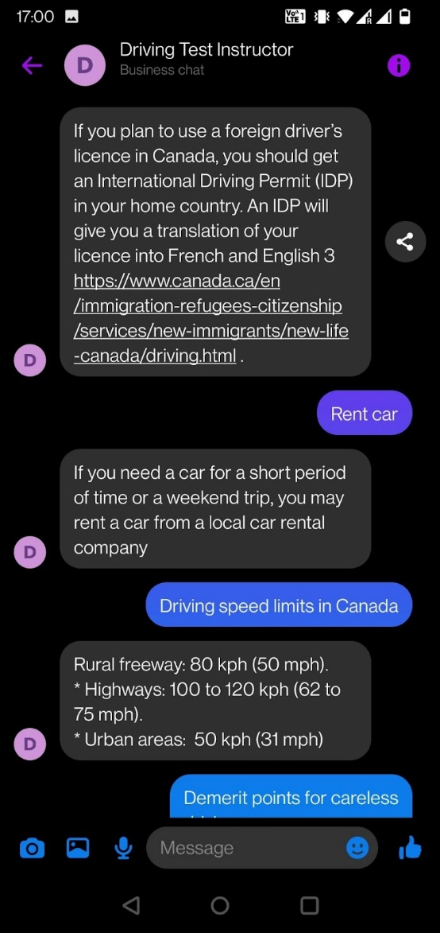
Facebook Messenger Integration:

Slide 8
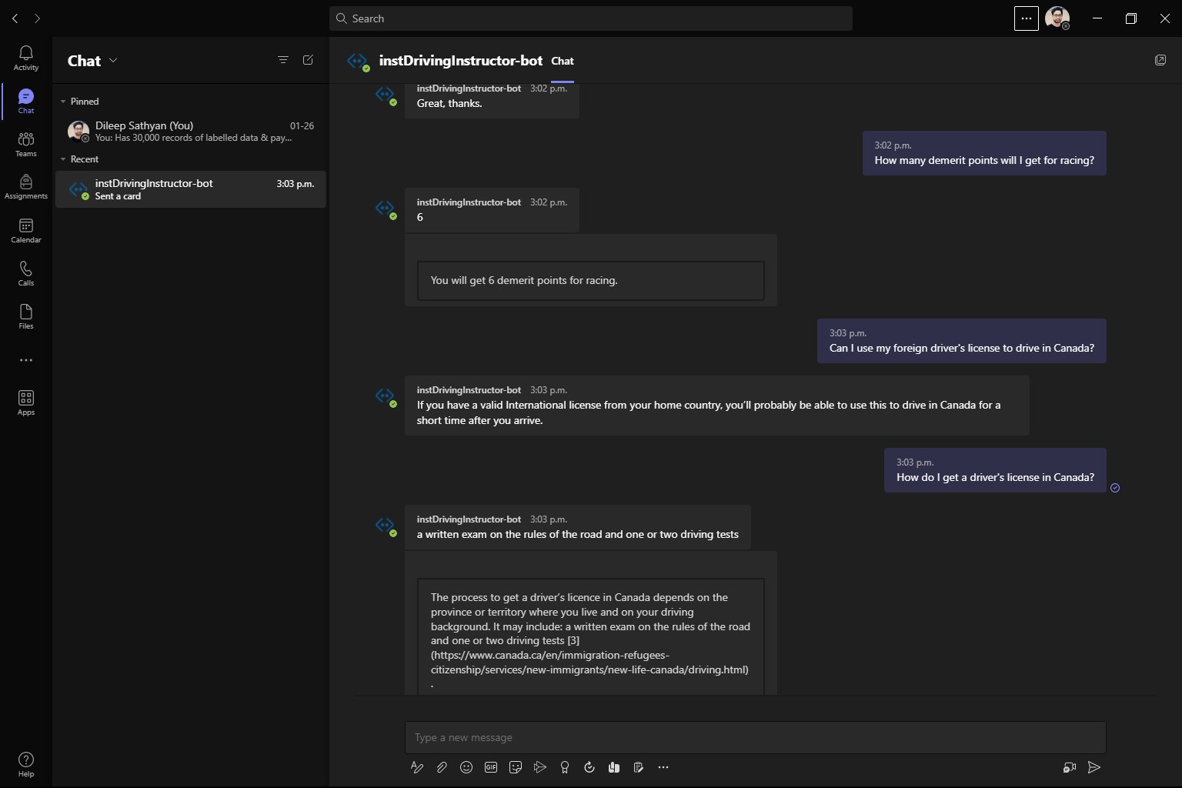
Microsoft Teams Integration:

Slide 9

Demo:

Slide 10
Recommendations & Room For Improvement:
Microsoft Azure’s paid version allows more than 3 resources onto the knowledge base which will strengthen the range and quality of answers.
Using Cognitive Services helps adding more voice-controlled Channels such as Alexa.
Custom text classification services with the help of LUIS (Language Understanding Service) can also be integrated with the QnA Maker for better understanding of the user input and to get more precise responses.

Slide 11
Thank you!

